Slide 1
CT3112: Professional Skills – Ethics component
Lecturer: Dr Orla Richardson
U. of G. Discipline of Philosophy
Week 10: Lecture 3
Email: Orla.Richardson@universityofgalway.ie

Slide 2
Ethics Component: Overview
Assessment
Online Ethics MCQ
25 questions
Worth 25 points
MCQ release date: 15/03/24
MCQ close date: 22/03/24
One attempt only. Not timed but once you start the MCQ you must finish it on that attempt

Slide 3
Week 10 Videos:
Environment ethics and engineering activity
Computer ethics and engineering activity
In the context of both domains of activity, what is the scope of an
engineer’s obligations and responsibilities?
Environmental ethics concerns how we humans relate to our habitat, and how we deal with the various problems that arise with that interaction.
Computer ethics focuses on the
values and practices that govern the process of consuming computing technology (and related disciplines). It isolate and assesses the ethical issues that result from the use of computers.

Slide 4
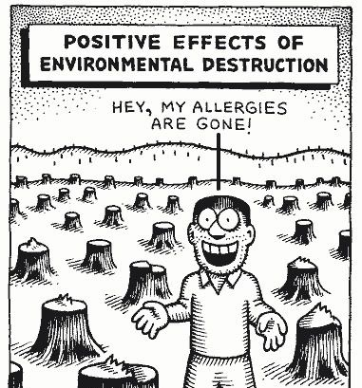
‘Environmental ethics is the discipline in philosophy that
studies the moral relationship of human beings to, and
also the value and moral status of, the environment and
its non-human contents.’ (Brennan, 2022)
Engineering and
Environmental Ethics
Notes:
Brennan, Andrew and Norva Y. S. Lo, "Environmental Ethics", The Stanford Encyclopedia of Philosophy (Summer 2022 Edition), Edward N. Zalta (ed.), URL = <https://plato.stanford.edu/archives/sum2022/entries/ethics-environmental/>.

Slide 5
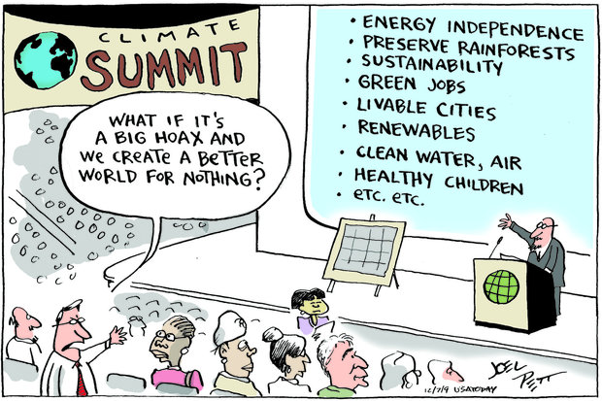
We have already
talked about your
obligations and
responsibility to
public health and
safety
Now we want to think about the technological impact of
engineering activity on humans but also on non-human
animals and the environment.
Notes:
Brennan, Andrew and Norva Y. S. Lo, "Environmental Ethics", The Stanford Encyclopedia of Philosophy (Summer 2022 Edition), Edward N. Zalta (ed.), URL = <https://plato.stanford.edu/archives/sum2022/entries/ethics-environmental/>.

Slide 6

The Code of Ethics (2023)
Guide on sustainability and ethics (WK10)
Guide notes to the interpretation of the code (WK08)
‘Climate breakdown and biodiversity collapse are the most serious issues of our time, and transformational action is required to achieve meaningful outcomes. The planet has ecological limits and a finite biocapacity, a paradigm shift is required to realign humanity’s ecological footprint within this capacity. Indeed, with our existing technologies and fossil fuel dependence, we will fail to achieve our existing commitments.’ EI GSE

Slide 7
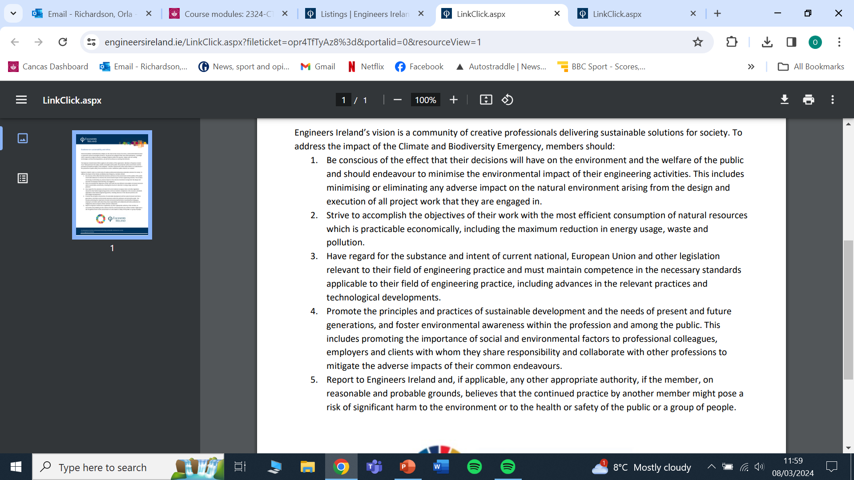

Slide 8
Sustainable Development: “development that meets the needs of the present without compromising the ability of future generations to meet their own needs” Brundland Report (1987)
Intergenerational equity – ‘duties’ that current generations have to future generations
Foster environmental Awareness

Slide 9
Questions for you:
Why do you think engineers should care about the environment?
How do you view the relationship between the environment and
your work?
Engineers clearly have responsibilities when ‘environmental
issues’ have an undisputed impact on human health and safety (ex. pollution that affects human health) but to what extent should concerns for non-human nature matter?
If nature matters (independently of human interests), why should it matter?
Or is any argument for non-human nature always dependent upon us – indirect not direct impact?

Slide 10
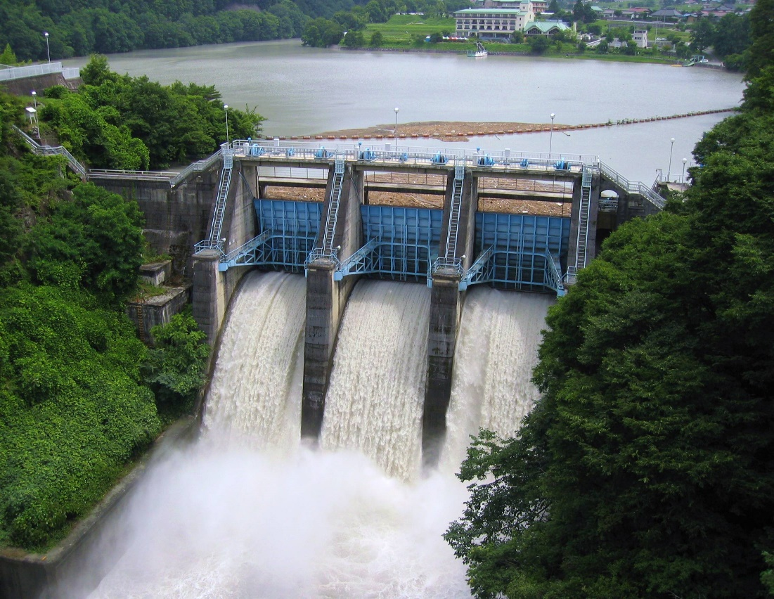
Case Study 14:
Professional or Personal Ethics?
When engineering activity may have an environmental impact but one that does not directly raise issues of human health.
If you are concerned about participating in such activity, does that concern come from a personal set of ethical principles or is it possible to say it comes from a professional ethical viewpoint?

Slide 11

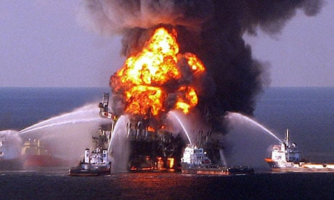
Let’s start thinking about
how we view our natural
environment by looking
at another case study.
Case Study 15:
The Deepwater
Horizon
disaster
2010

Slide 12
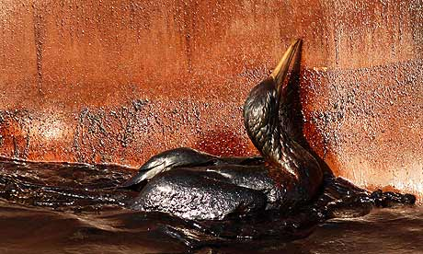
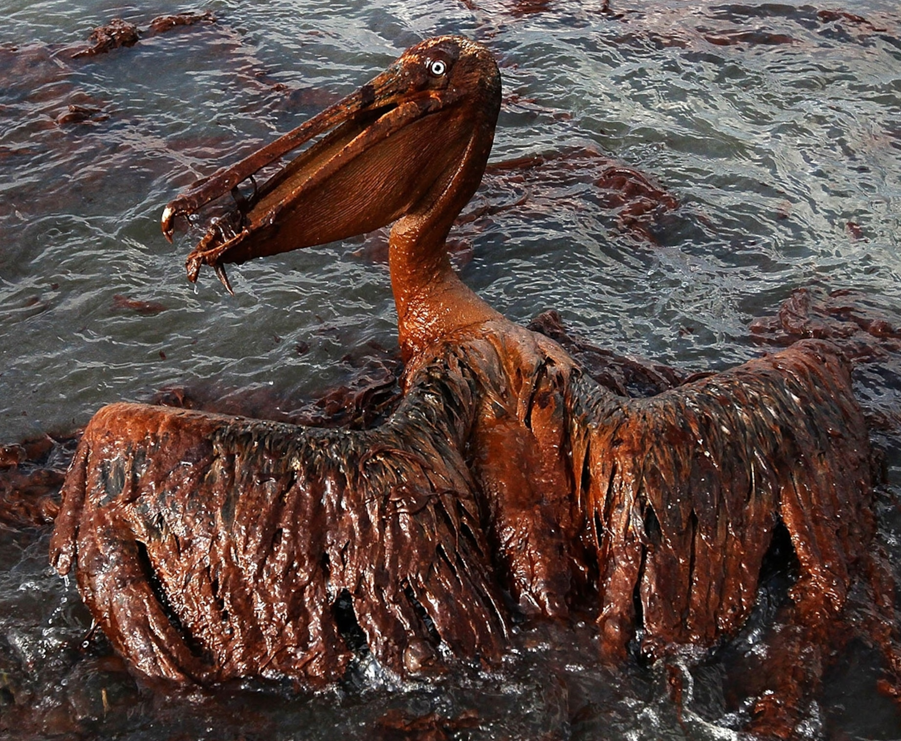

Loss of 11 lives. World’s largest accidental oil spill.
Massive environmental damage to the Gulf. Huge
impact on coastal communities (Louisiana, Mississippi & Florida).
Multi-billion-dollar loss to BP.

Slide 13
The Deepwater Horizon platform was a great technological
achievement capable of drilling oil wells a mile deep. It cost $1m a
day to run and was 45 days behind schedule.
Transocean, the biggest offshore drilling firm in the world, was the
company BP had contracted to carry out the drilling.
Two senior offshore representatives of Transocean, Jimmy Harrell
and Jason Anderson (who died on the rig) warned of safety risks.
Anderson had confided in his father about his worries: “Dad, they are doing things that I really don’t like – pushing us to do things that are not safe...If this keeps up, they will kill every one of us.”
Their concerns were ignored and a blowout due to failure to control pressure
between the reservoir and the rig resulted in the accident

Slide 14
Case Study 15:
Many commentators suggest that
the DH disaster was about
prioritising profit over human
safety and environmental
protection.
An example of us exercising our technological prowess without appropriate concern for ourselves
or for the environment.
If this is a fair analysis, what makes us neglect to consider or minimise the environmental implications of our actions?
One possible answer: a deeply anthropocentric worldview

Slide 15
Anthropocentric: Considering human animals to be the most morally significant species on the plant
‘Many traditional western ethical perspective are anthropocentric or human-
centered, they either assign intrinsic value to human beings alone or they assign a
significantly greater amount of intrinsic value to human beings than to any non-human things such that the protection or promotion of human interests or well-being at the expense of non-human things turns out to be nearly always justified.’
(Brennan & Lo, 2022)
Distinction: Instrumental value and Intrinsic value (non-instrumental)
Instrumental value:
‘value of things as means to further some other ends’ (Brennan & Lo, 2022)
Intrinsic value:
‘value of things as ends in themselves regardless of whether they are also useful as means to other ends’ (Brennan & Lo, 2022)
Notes:
Brennan, Andrew and Norva Y. S. Lo, "Environmental Ethics", The Stanford Encyclopedia of Philosophy (Summer 2022 Edition), Edward N. Zalta (ed.), URL = <https://plato.stanford.edu/archives/sum2022/entries/ethics-environmental/>.

Slide 16
Do humans view nature as subservient to human needs (trees to be harvested, rivers harassed, wildlife to be managed, land developed)?
Implication: We mistreat (view instrumentally, as a resource to be used/manipulated) our very source of life. We fail to see nature as a shared resource, an interdependence between inhabitants.
Is anthropocentrism a key problem?
Reflect on Deepwater Horizon
Do you think anthropocentrism is the big problem?
Is it just this or do you think there are other factors?
List them for yourself and think about the moral significance of each.

Slide 17
We think that a relatively straightforward case can be made to
show that engineers are morally responsible for ‘the negative
effects’ their technology has on:
Human beings.
Future generations (trickier)
But can engineers be held accountable for engineering activity
which is “legal” and does not directly harm anyone (human
animals)?
Non-human nature
Non-human animals
The ecosystem as a whole
We may be able to argue for
appropriate consideration indirectly,
in anthropocentric terms.
But can we argue for consideration
directly too?

Slide 18
How do we generate ‘a moral responsibility’?
Q: Do we owe moral consideration to other human beings?
One answer using a normative framework that we are already familiar with:
Duties
Other human beings are considered as ‘persons’ (legal and a moral
term) – they have rights, they must be treated in a certain way.
Possible personhood markers:
Capacity for thought and language, ability to reciprocate moral concerns (empathy), capacity to choose actions, have interests, sentient.

Slide 19
How do we generate ‘a moral responsibility’?
Q: Do we owe moral consideration to other human beings?
Another answer:
Consequences
Other human beings are stakeholders in the outcomes of actions
(particular actions that affect the environment)
Utilitarianism – the happiness of others is a concern (sentient
creatures who want to minimise pain and maximise pleasure)
In both cases, your consideration of their situation/interests is a
factor in ethical decision-making regarding the environment.

Slide 20
How do we generate ‘a moral responsibility’?
Q: Do we owe moral consideration to future generations?
Tim Mulgan writes in Ethics for a Broken World
“The idea that we hold the resources of the earth in trust for
future generations was a very powerful one for many affluent
people. They could have applied it to their collective decision-
making. Unfortunately for us, and for the future of our world, they
did not.”
(Mulgan, 2011, 220)

Slide 21
How do we generate ‘a moral responsibility’?
Q: Do we owe moral consideration to future generations?
A version of Social Contract from a conservative perspective:
Edmund Burke writes in ‘Reflections on the Revolution in France’ (1790):
“…Society is but a contract between the dead, the living, and those
yet to be born”. (Burke, 1992)
Deontology argument:
We have a duty to future generations as future persons
We must pass on particular aspects of our world in a state at least as good as that inherited from the previous generation.

Slide 22
Consequentialist argument (Utilitarian version):
When we consider a calculation of positive and negative consequences we should include, as stakeholders, future generations.
Principlism:
Technology (engineering activity) has created environmental problems but it also has the capacity to fix (or minimise) such problems.
Applying the principles of justice, beneficence and maleficence (to the case of others and future generations) we can argue that engineers must look to rectify, minimise or eliminate environmental harms.

Slide 23
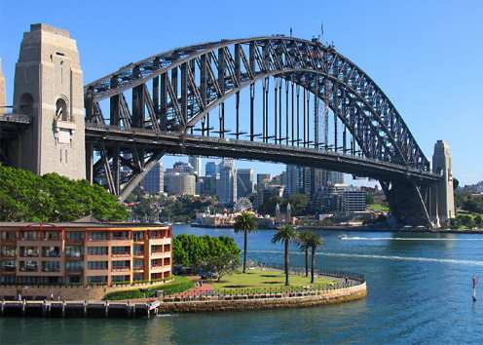
Case Study 16:
Habour
Tunnel EIS
Can the environment really be protected by ethical
conduct (given economic and professional factors)?

Slide 24
Q: Do we owe moral consideration to the non-human world (non-
human animals/ecosystems)?
One answer:
Yes.
Generates a moral responsibility but an indirect one.
Because of the following anthropocentric (human-centred) reasons:
First possible answer

Slide 25
Reasons:
Natural beauty is important for human beings, we enjoy natural
diversity.
Vital to the economy, expense to replace free natural services.
Cultural/religious value (we value) of non-human animals/habitats
We rely for survival on the ecosystem as a whole – our habitat too.
We could say that if non-human animals and the eco-system as a whole are necessary for the flourishing of human then they are owed moral consideration to the extent that their preservation or otherwise benefits humankind. Indirect and limited responsibility.

Slide 26
Q: Do we owe moral consideration to the non-human world (non-human animals/ecosystems)?
Another answer:
Yes.
Generate a form direct responsibility – rights exists /obligations accrue
Because non-human animals and ecosystems have an intrinsic
value

Slide 27
Reasons:
Intrinsic value (1) – non-instrumental entity (not a thing that can
be used as a means but is an end itself - valuable for its own sake)
Intrinsic value (2) – valuable in virtue of a set of essential
properties
Intrinsic values (3) – objective value – independent of assessment
or perspectives of valuers.
Why?
Sentience - all sentient creatures
Bio-ethics - solidarity with any organic life form that experiences
the environment, can struggle to live, can flourish or fail.
Notes:
Aldo Leopold A Sand County Almanac - land ethic (1949)

Slide 28
3. Eco-centric ethics - consider systems not individuals
Aldo Leopold writes in A Sand County Almanac about a ‘land
ethic’:
He says:
‘land is a community…the basic concept of ecology, but that land is to be loved and respected is an extension of ethics.’ (Leopold 1949: vii–ix)
‘A thing is right when it tends to preserve the integrity, stability, and beauty of the biotic community. It is wrong when it tends otherwise.’ (Leopold, 1949, 224–5)
Notes:
Aldo Leopold A Sand County Almanac - land ethic (1949)

Slide 29
Q: Do we owe moral consideration to the non-human world (non-
human animals/ecosystems)?
Example: Global Warming
Global warming refers to the heating (long-term) of the entire
planet. The pace of warming has increased over the last 100 years
primarily due to the use of fossil fuels.
The heating results from the effects of greenhouse gas emissions
(GHGs). Our GHG emissions are caught in the earth’s atmosphere,
which warms the planet.

Slide 30
The majority of active publishing climate scientists say that the
planet is warming and the main cause of this is human activity
Global Warming causes Climate Change (climate crisis)
Climate change refers to changes in weather patterns, growing
seasons, rising sea levels caused by warmer seas and melting ice
sheets/glaciers.
Consequences: some animals will suffer from heat, lack of water,
melting ice, lack of food, reduction in or disappearance of usable
habitat, flooding, fires, climate-related disease, or other extreme
weather events.
(Source - IPCC Assessment Report).
Notes:
https://www.ipcc.ch/report/ar6/wg2/

Slide 31
Q: Do we owe moral consideration to the non-human world (non-human animals/ecosystems)?
Anthropocentric answer: the non-human world has instrumental
value (means to an end) but engineering activity must ensure that
any ‘harm’ to the environment is not detrimental to human
flourishing.
Limited form of responsibility, obligation owed to other humans
(and perhaps future generations) but not to nature itself.
Global warming: a moral problem if it affects human beings.

Slide 32
Q: Do we owe moral consideration to the non-human world (non-human animals/ecosystems)?
Intrinsic value answer: the non-human world has intrinsic value
(like a person), engineering activity must consider it directly,
obligations are owed to it.
Global warming: if global warming adversely effects non-human
animals and non-human eco-systems, and humans are responsible
for global warming then human have ‘wronged’ these non-human
animals and eco-systems
Righting this wrong is a moral issue.

Slide 33


Other relevant Professional Codes:
Code of Conduct (IEEE):
https://www.ieee.org/about/index.html
https://www.ieee.org/about/corporate/governance/p7-8.html
Association for Computing Machinery Code of Conduct
https://www.acm.org/about-acm/mission-vision-values-goals
https://www.acm.org/code-of-ethics
Code of Conduct (Software Engineering - produced by IEEE CS)
https://www.computer.org/education/code-of-ethics

Slide 34
Aims of Computer Ethics:
To make students aware of the ethical issues surrounding
computers
Computer ethics focuses on the values and practices that govern the process of consuming computing technology (and related disciplines). It isolate and assesses the ethical issues that result from the use of computers.
Computer Ethics is a relevant component of engineering ethics
for all engineers because of the significance of computer technology in engineering education, engineering activity, and the design and provision of engineering products.
Notes:
D. Johnson Computer Ethics (2005)

Slide 35
Aims of Computer Ethics:
To heighten their sensitivity to ethical issues in the use of
computers and in the practice of computing professions
to provide conceptual tools and develop analytical skills for sorting
out what to do when in situations calling for ethical decision making
or for sorting out what the likely impacts computer technology will
have in this or that context (Johnson, 2005, 6)
To give them more than a superficial understanding of the ways in
which computers (do and don't) change society and the social
environments in which they are used

Slide 36
Some examples of computer-related ethical issues:
Digital divide:
Equality, or otherwise, of access to information technology.
The ‘divide’ is fuelled by economic, social, cultural, and
geographical factors.
Generating inequalities in access to resources and opportunities.
These inequalities are particularly worrying as they have the
power to further perpetuate existing structural inequalities.

Slide 37
Social effects of computers on operators, users, and the public
focusing on preventing harms and promoting benefits
Harms: Biased or false information like social media algorithms
that target and spread disinformation online (social and political)
Harms: Forms of harassment (cyberbulling, trolling, deepfake
technology, etc)
Related issue: Free speech
How to balance the goods of free speech and public dialogue with
the potential harms of disinformation and orchestrated manipulation in online settings.

Slide 38
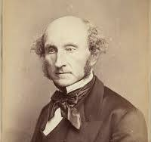
Market-place of ideas: No suppression of controversial or unpopular
views because the view may be
True
False
Part truth & part falsehood.
In each case, suppression is harmful.
Related issue: Privacy and anonymity
How the balance the goods of privacy and anonymity (security – speech, association, health, pursuit of personal expression and self-fulfilment) with the harms of privacy and anonymity (criminal behaviour, unethical behaviour)
Mill: 1. Lose chance to exchange truth for error, 2. lose chance to practice our skills of critical assessment and resist truth becoming a dead dogma, 3.lose chance to extract the part that is truth.
J.S. Mill 1806 - 1873
Notes:
Mill, J. S. On Liberty (1974) pages 115-117

Slide 39
Intellectual property in the digital age
Should all information be free?
Ex: Should software (applications, scripts, programmes, etc) be
available for use and/or copying – promoting access to learning,
access to information, access to further development or
modification.
What about the issue of Ownership?
- Protecting and respecting the rights of creators and developers to
things the make, to their livelihood associated with those things,
and to the economic health of companies/institutions that employ
them.

Slide 40
Ownership?
- What do creators and developers own?
- Co-creators?
- Incorporating or using existing innovation?
Computer systems safety
- Engineering decisions can affect the functionality of computer systems (affecting users directly/the public indirectly).
- Computing has real world effects and consequences – think of the use of intelligent devices in environment systems, transport, medical settings, weapons and other safety-critical systems

Slide 41
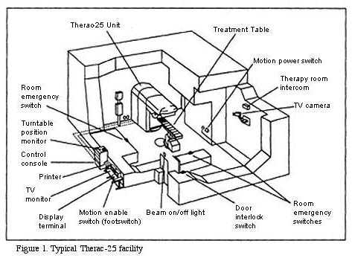
Case Study 17:
Therac 25
When design and use
of software in
safety-critical
applications fails who
Is responsible
Therac-25 was a medical linear accelerator (targeted X-ray beams on cancerous tissue). Operators were told that there were "so many safety mechanisms" that it was "virtually impossible" to overdose a patient, this is exactly what did occur in six documented cases

Slide 42
Artificial Intelligence (AI)
- A lack of transparency (opacity) about how AI works:
Example: A decision-making process affects a person in a particular way (the fail
to get a mortgage from a bank), that person has no idea how the decision was
made. Raises questions of due process, accountability and oversight.
- Potential bias in the algorithms use in AI:
Algorithm bias is the result of subjective choices made by humans
when selecting, collecting and preparing date. Decisions that
programmers make and the biases they may carry with them out in
the decision-making algorithms created in AI.
‘artificial intelligence (AI) is understood broadly as any kind of artificial computational system that shows intelligent behaviour, i.e., complex behaviour that is conducive to reaching goals.’ (Muller, 2023)
Notes:
Müller, Vincent C., "Ethics of Artificial Intelligence and Robotics", The Stanford Encyclopedia of Philosophy (Fall 2023 Edition), Edward N. Zalta & Uri
Nodelman (eds.), URL = <https://plato.stanford.edu/archives/fall2023/entries/ethics-ai/>.

Slide 43
- Potential bias in the algorithms use in AI: Example (2018)
Amazon had to pull its artificial intelligence (AI) recruiting tool when
it became clear that it had a gender bias. The tool was used to search
the web and find potential hires, rating those hires on a scale of one
to five stars. The algorithm was systematically scoring women’s CV’s
for certain jobs - software developer for instance – lower than men.
- AI and work
Claim: AI = more productivity. More productivity = More wealth.
More wealth = More leisure
Questions: What could a just of the distribution of goods that emerge
from AI look like? Will that just distribution happen?
Notes:
https://www.irishtimes.com/business/technology/amazon-scraps-secret-ai-recruiting-tool-that-showed-bias-against-women-1.3658651

Slide 44
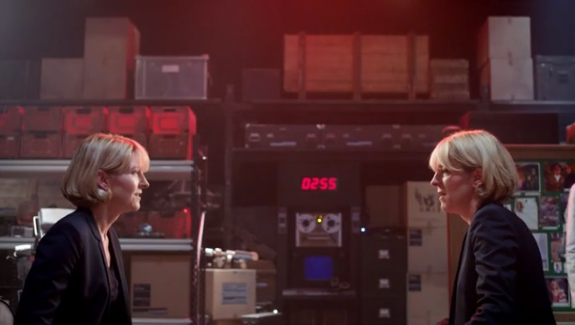
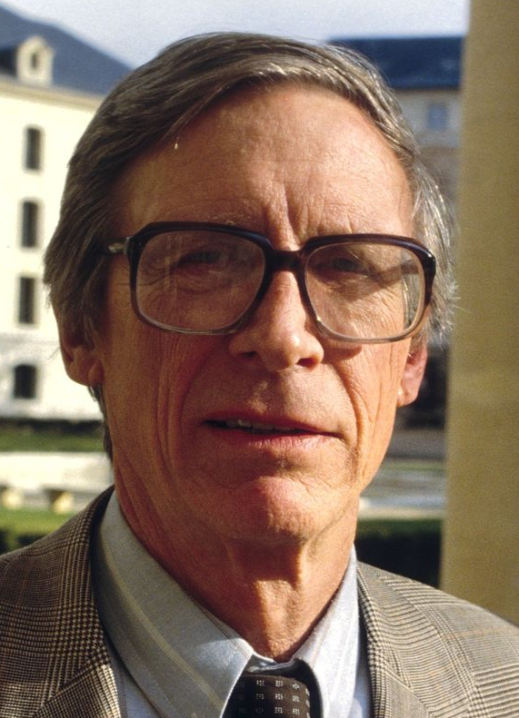
John Rawls
A Theory of Justice
(1971)
How do we come up with principles of justice that are fair?
Decide from behind a veil of ignorance – where we don’t know who
we are or who we will be (ignorance restricts bias)
Difference Principle: social and economic inequalities are to be
arranged so that they are reasonably expected to be to everyone’s
advantage (especially the least advantaged)
Will the AI economy adhere to the difference principle?
Doctor Who – Day
of the Doctor
Notes:
Zygons and Humans

Slide 45
Muller argues it won’t for the following reasons:
‘First, it operates in a largely unregulated environment where responsibility is often hard to allocate.
Second, it operates in markets that have a “winner takes all” feature where monopolies develop quickly.
Third…it is difficult to control multinational digital corporations that do not rely on a physical plant in a particular location.
These three features seem to suggest that if we leave the distribution of wealth to free market forces, the result would be a heavily unjust distribution…’
(Muller, 2023)
Notes:
Müller, Vincent C., "Ethics of Artificial Intelligence and Robotics", The Stanford Encyclopedia of Philosophy (Fall 2023 Edition), Edward N. Zalta & Uri Nodelman (eds.), URL = <https://plato.stanford.edu/archives/fall2023/entries/ethics-ai/>.

Slide 46
AI and work:
Job losses
Job replacement.
Example: Robots as carer (carebots)
‘The use of robots in health care for humans is currently at the level
of concept studies in real environments, but it may become a usable
technology in a few years, and has raised a number of concerns for a
dystopian future of de-humanised care. (Muller, 2023)
https://www.theguardian.com/society/2023/may/21/care-bots-care-tech-uk-robots-carers-emily-kenway
Notes:
Müller, Vincent C., "Ethics of Artificial Intelligence and Robotics", The Stanford Encyclopedia of Philosophy (Fall 2023 Edition), Edward N. Zalta & Uri Nodelman (eds.), URL = <https://plato.stanford.edu/archives/fall2023/entries/ethics-ai/>.

Slide 47


- Could AI threaten humanity’s existence?
Nick Bostrom
(1973-)
‘..seems perfectly possible to have a superintelligence whose sole goal is something completely arbitrary, such as to manufacture as many paperclips as possible, and who would resist with all its might any attempt to alter this goal.’ (Bostrom, 2003, 14)
Thought Experiment: Imagine an AI whose task it to create as many paperclips as possible. Fully focused, improves and/or replicates itself to continue with the task while resisting attempts to stop it. Turns the planet into a paperclip manufacturing plan eventually
destroying us all. Doesn’t have motivations like us, and we don’t have the requisite control
if this happens. AI not just another form of technology but an existential threat.
Notes:
On-line – Ethics of artificial Intelligence and Ethical Issues in Advanced Artificial Intelligence
Cognitive, Emotive and Ethical Aspects of Decision Making in Humans and in Artificial Intelligence, Vol. 2, ed. I. Smit et al., Int. Institute of Advanced Studies in Systems Research and Cybernetics, 2003, pp. 12-17

Slide 48
Privacy and data protection
“Our interest in privacy…is related to our concern over our
accessibility to others: the extent we are known to others, the extent to which others have physical access to us, and the extent to which we are the subject of others’ attention.”
(Harris, Prichard & Rabins, 2009, 105)
The Goods of Privacy:
Privacy promotes liberty, autonomy, selfhood, and human
relations, and furthering the existence of a free society. (R. Gavison, 1980).
Privacy prevents interference, pressures to conform, ridicule,
punishment, unfavourable decisions, and other forms of hostile reaction.’ (R. Gavison, 1980)
Notes:
Engineering Ethics: Concepts and Cases
The Yale Law Journal Volume 89, Number 3, January 1980 Privacy and the Limits of Law Ruth Gavisont

Slide 49
Legitimate limits on access to information:
Personal privacy (financial, medical, contact, and personal details)
– issue of consent, expectation that ownership of information will be respected
Corporate security freedom (protect proprietary - information,
designs, processes).
National security
Withholding information from the public.
Legally beaching privacy with data collection and surveillance.
Q: How much information should governmental bodies be allowed to collect?
Q: For what purposes?
Notes:
Edward Snowden was a computer analyst who worked for CIA and NSA. Snowden leaked classified material to the press about invasions of privacy on the internet. The NSA were looking at millions of e-mails, instant messages, contact lists, tracking mobile phones, spying on users of online games, tracking individuals online sexual activities, spying on world leaders

Slide 50
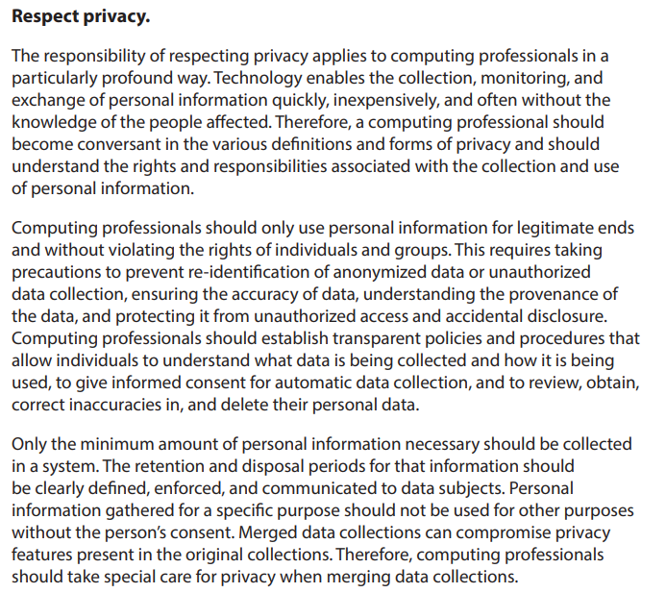
AMC
Code of
Ethics:
1.6
‘Respect
privacy’
Notes:
AMC Code of Ethics

Slide 51
Computing and Privacy:
Possible to design many forms of data collection within many
types of computer-related applications.
Possible for users to remain oblivious to the fact that their
data is being collected (actions often occur beyond the "front-end“
of a device)
Digital data collection allows uses that may not have been
anticipated by designers
Punchline: You need clear and effective policies and procedures for
collecting data (consent), storing and managing data, ensuring the
accuracy of data, disposing of data
Notes:
Engineering Ethics: Concepts and Cases

Slide 52
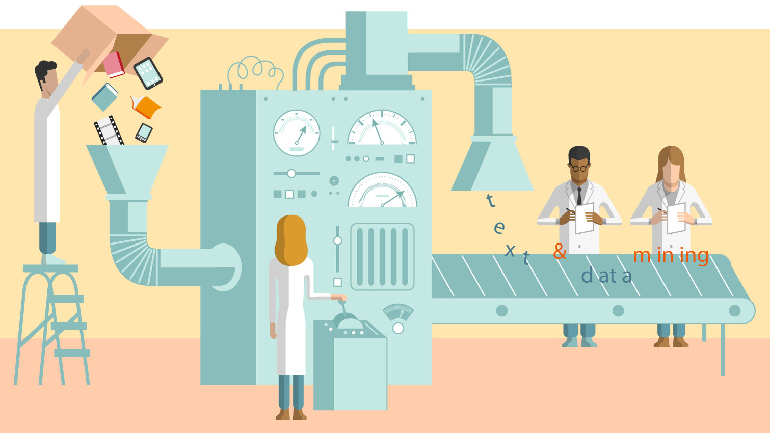
Case Study 18:
Data Mining
Assess the
ethical concerns
that you think
are relevant
in this case

Slide 53

Case study 19
Cambridge Analytica –
A Case Study by
Harshil Kanakia, Giridhar
Shenoy and Jimit
Shah
Facebook users’ data harvested, used to create an algorithm which by understanding the personality traits of individuals could be used as a tool to influence US Presidential Elections (2015)

Slide 54
Ethics Component: Overview
Assessment
Online Ethics MCQ
25 questions
Worth 25 points
MCQ release date: 15/03/24
MCQ close date: 22/03/24
One attempt only. Not timed but once you start the MCQ you must finish it on that attempt

